Slide 1
MATLAB Session 1
Programming Camp 2016

Slide 2
Why MATLAB?
Easy to use scripting language for linear algebra
Built-in numerical computation:
Matrix decompositions;
Numerical integration;
Optimization etc.
Plotting in tractable and appealing way

Slide 3
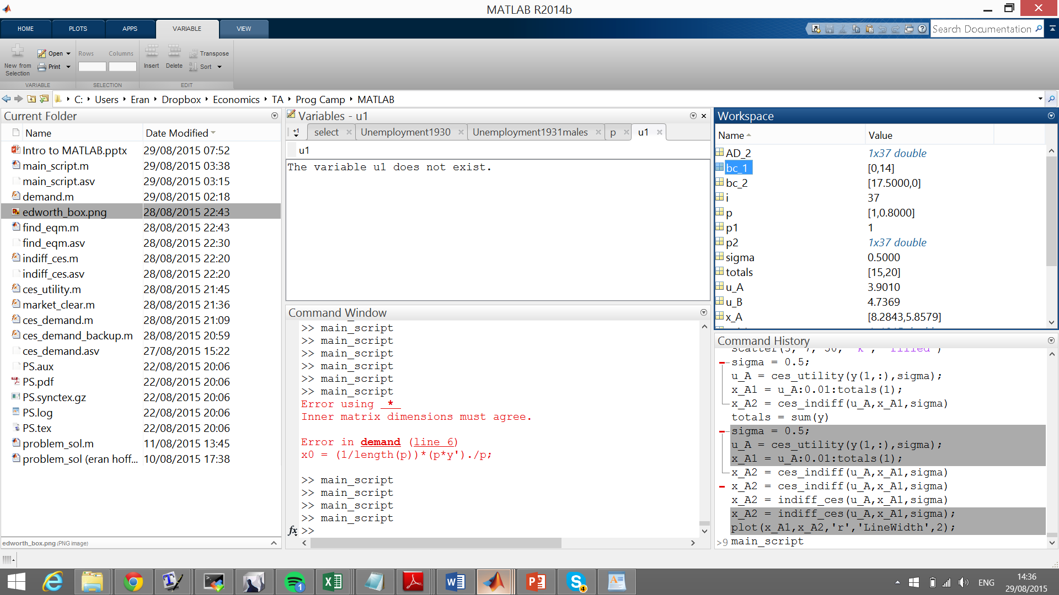
Variables
Workspace
Current Folder
Command Window
Command History

Slide 4
Most Important:
If you don’t know, Google it! (someone must have had the same problem)
Help!
>> help <command>
>> doc <command>
>> lookfor (somewhat inferior to google)
Demos and examples

Slide 5
Basic Syntax I
semicolon ;
>> 4+5;
% for comments
>> 4*5 %-6
assignment
>> y = 4^5
matrix assignment
>> y = [1,2;3,4]

Slide 6
Basic Syntax II
Clear Close CLC
clear all; close all; clc
Single element assignment
>> y(2,2) = 4^6
Transpose
>> y = y’
Logical
>> y = (y == 0)

Slide 7
Basic Syntax III
stop
ctrl+c
colon operator
>> x = -pi:0.1:pi;
call functions
>> y = sin(x);
logical statement to select elements
>> y(y>0.5) = 0.5;

Slide 8
Basic Syntax IV
* vs .*
>> x*x
>> x.*x
strings
>> [‘two ‘ ‘words’]
strings are also matrices…
>> ans’

Slide 9
Basic Syntax V
size
>> size(x)
>> size(x,2)
zeros
>> zeros(5,3)
create a matrix of the same size
>> zeros(size(x))

Slide 10
Basic Plotting
Create a figure
>> figure;
Line plot
>> plot(x,y);
title; xlabel; ylabel;
>> title(‘myplot’); xlabel(‘x’); ylabel(‘y’);
Scatter plot
>> hold on; scatter(x,y);

Slide 11
Saving and Loading
save(‘filename’, ‘vars’);
load(‘filename’);

Slide 12
Example 1: Patients
Load files
Plotting
Regression

Slide 13
load patients
Male = strcmp(Gender,'Male');
Female = ~Male;
figure;
scatter(Height(Male),Weight(Male))
hold on;
scatter(Height(Female),Weight(Female))
legend('Male','Female')
xlabel('Height'); ylabel('Weight');

Slide 14
Backslash
When you enter the command:
x = A\B
Matlab solves for x.

Slide 15
Age = Age(Female);
Height = Height(Female);
Weight = Weight(Female);
Smoker = Smoker(Female);
X = [ones(sum(Female),1) Height];
b = X\Weight

Slide 16
Practice (10 minutes)
Use plot() to add a regression line for males
Can you find what is the effect of smoking on weight?

Slide 17
MATLAB Session 2
Programming Camp 2015

Slide 18
Coding
M-files, <filename>.m
>> <filename>
Functions
function <outputvars> = <fname>(<inputvars>)

Slide 19
Control Flow
for i = 1:10
statements
end
while d > 0.01
statements
end
if x == 0
statements
else
statements
end

Slide 20
Recursion
Solving one problem depends on the solution to smaller problems.
Recursion is a powerful tool, but two things can make it slow or memory intensive:
Naively and repetitively performing the same computations.
Ever expanding computations that need to be held in memory.
We’ll go through examples to show you both the power and the problems.

Slide 21
Factorial
The function factorial of 3:
3 * 2 * 1
Can also be written recursively:
factorial(3) = 3*factorial(2)
factorial(3) = 3*2*factorial(1)
factorial(3) = 3*2*1*factorial(0)
factorial(3) = 3*2*1*1

Slide 22
Recursive Factorial in Pseudocode
What does that function factorial(n) look like in pseudocode:
if n==0 then return 1
If n~=0 then return n*factorial(n-1)

Slide 23
Example 1: Fibonacci
f(1) = 1; f(2) = 1;
f(n) = f(n-1) + f(n-2);
Write code that returns the nth element
Recursion
Loop
Practice: return first n elements

Slide 24
1. Recursion
function fib = fibo_recursion(n)
if n <= 2
fib = 1;
else
fib = fibo_recursion(n-1) + ...
fibo_recursion(n-2);
end

Slide 25
2. Loop
% intitialize the fibonacci series
fib = 1;
fib_prev = 1;
%
% iterate from element 3 on
for i = 3:n
temp = fib;
fib = fib_prev+fib;
fib_prev = temp;
end

Slide 26
3. Return Vector
a. Adjust the loop code to return the first n elements
b. Use tic/toc to time recursion and loop functions
Question:
How much time does it take to find n=30 element in three fun’cs?
Why are some faster than others?

Slide 27
Why is recursion slow in the Fibonacci example?
fib(n-1) + fib (n-2)
fib(5)
(fib(4) + fib(3))
(fib(3) + fib(2))+(fib(2) + fib(1))
(fib(2)+fib(1))+(fib(1)+fib(0))+(fib(1)+fib(0))+(fib(0))
We are re-computing the same thing over and over!

Slide 28
What could go wrong with our factorial example?
Think about the example of factorial(4)
factorial(4) = 4 * factorial(3)
factorial(4) = 4* 3 * factorial(2)
factorial(4) = 4* 3 * 2 * factorial(1)
factorial(4) = 4* 3 * 2 * 1 * factorial(0)
factorial(4) = 4 * 3 * 2 * 1 * 1
It’s growing…

Slide 29
What’s the issue?
Every step, we increase the size of what is being evaluated:
if n==0 then return 1
If n~=0 then return n*factorial(n-1)
Each recursive step requires the allocation of an additional “stack.”

Slide 30
Extra Credit: Tail Recursion
If, however, we use “tail recursion”:
function output = tail_recur_factorial(acc,n)
if n==0 return acc
else factorial(acc*n,n-1)
end

Slide 31
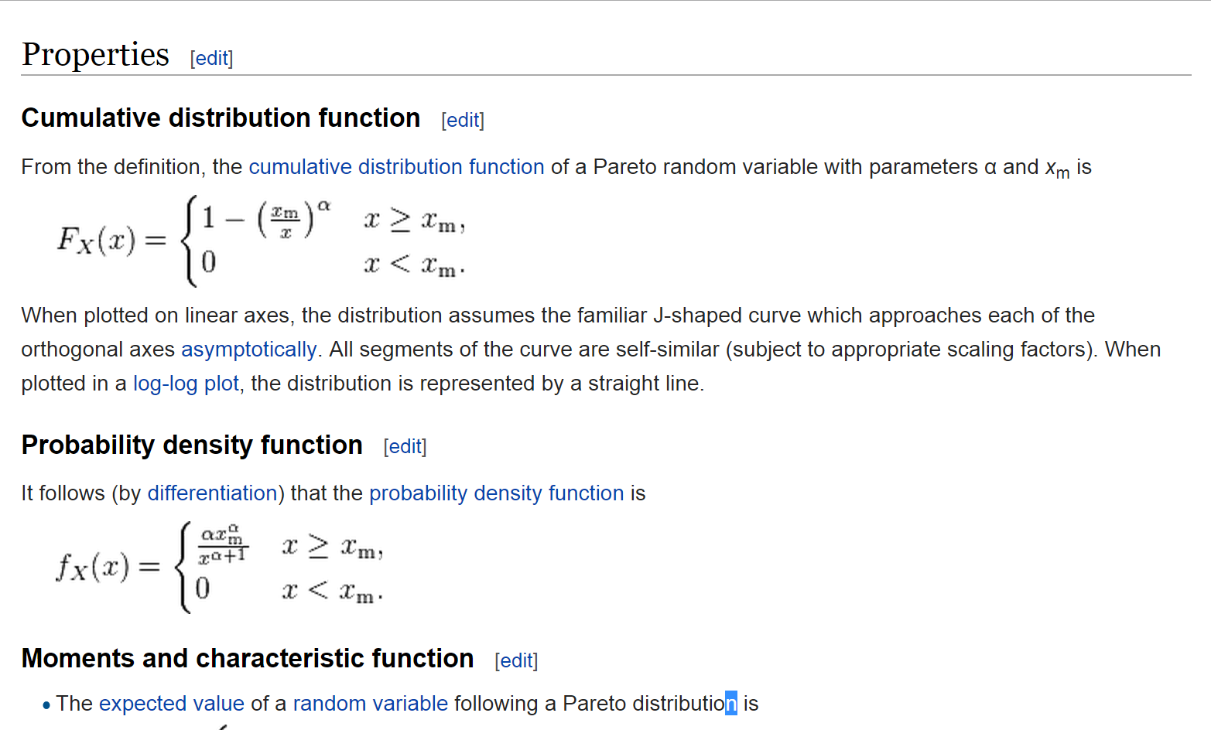
Example 2: Numerical int. / Pareto Distribution

Slide 32
Practice (5 minutes)
Write a function that returns the Pareto density (paretopdf):
inputs – x, x_m, alpha
output – density
Bonus :
Plot the Pareto density with parameters x_m = 1 and alpha = 2

Slide 33
Try this
function f = paretopdf(x,x_m,alpha)
f = zeros(size(x));
f(x>x_m) = alpha * x_m^alpha * ...
x(x>x_m).^(-alpha-1);

Slide 34
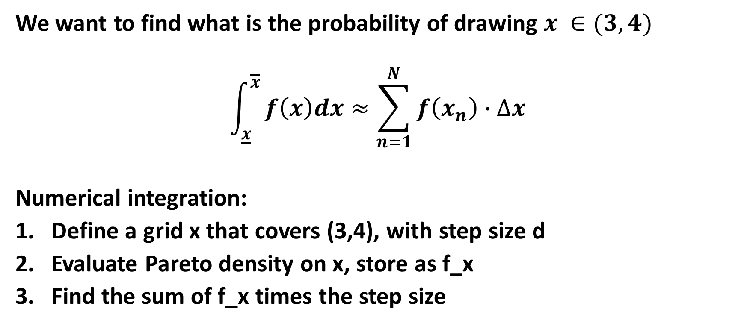
Practice (5 minutes)
We want to find what is the probability of drawing $x ∈(3,4)$
$$\int_{\underline{x}}^{\overline{x}}{f\left(x\right)dx≈\sum_{n=1}^{N}{f\left(x_{n}\right)}}∙∆x$$
Numerical integration:
Define a grid x that covers (3,4), with step size d
Evaluate Pareto density on x, store as f_x
Find the sum of f_x times the step size

Slide 35
Function Handles
Sometimes, it is useful to pass functions as arguments
f = @mean;
Fast and easy definition of new functions
add_one = @(x)(x+1);

Slide 36
Find Expected Value
alpha = 2; x_m = 1;
E_analytic = alpha*x_m/(alpha-1)
h = 0.1; x = 0:h:40;
f_x = paretopdf(x, x_m, alpha);
E_x1 = h*x*f_x’
f = @(x)(x.*paretopdf(x,x_m,alpha));
E_x2 = integral(f,0,40)

Slide 37
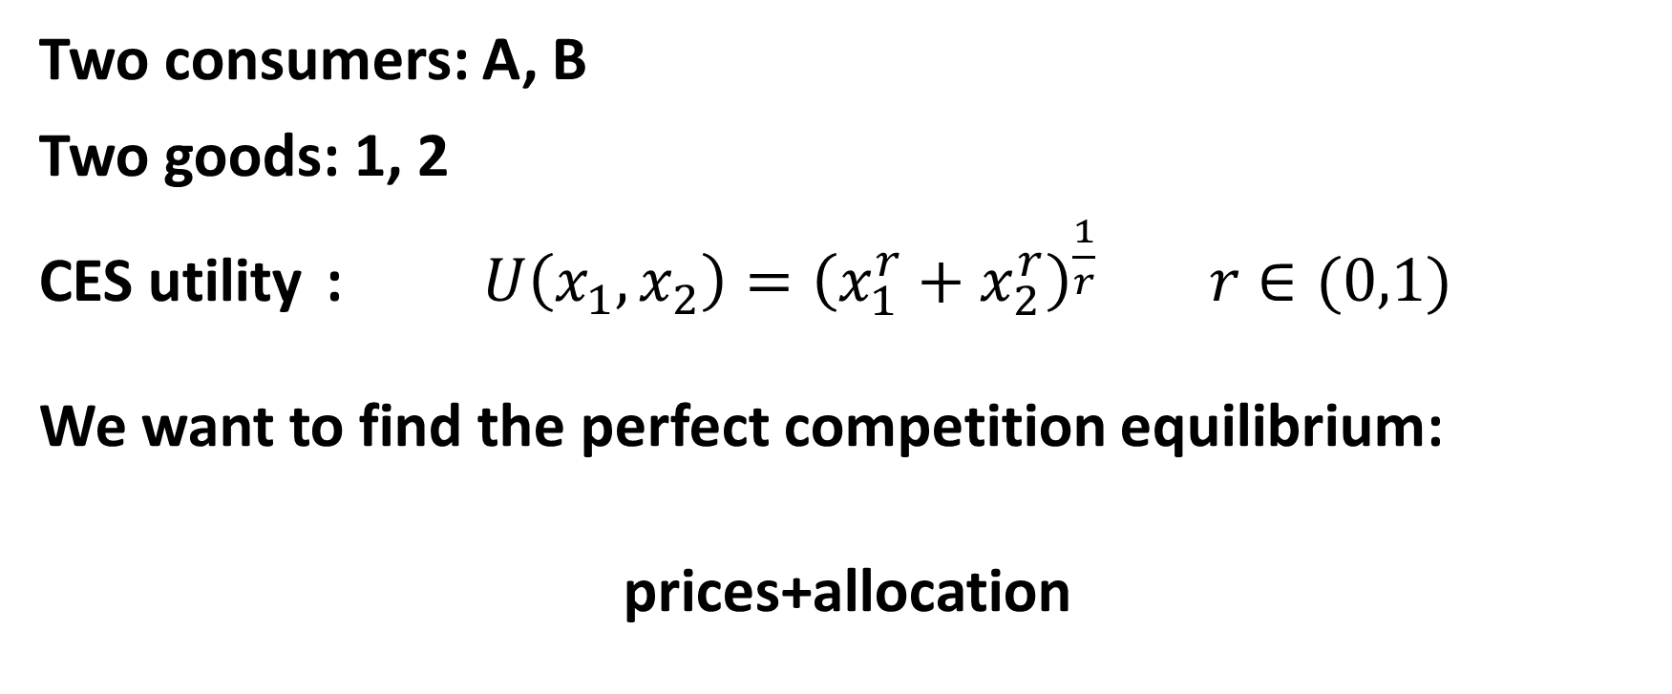
Example 3: Market eq’m without FOCs!
Two consumers: A, B
Two goods: 1, 2
CES utility : $U\left(x_{1},x_{2}\right)={\left(x_{1}^{r}+x_{2}^{r}\right)}^{\frac{1}{r}} r∈(0,1)$
We want to find the perfect competition equilibrium:
prices+allocation

Slide 38
Edgeworth Box
B
A

Slide 39
Step 1: Draw a Box
Set endowment y = [10 5; 5 40];
totals = sum(y);
figure; hold on;
rectangle(‘Position’,[0 0 totals],...
‘LineWidth’, 2);
scatter(y(1,1),y(1,2),50, ‘k’, ‘filled’);

Slide 40
ces_utility.m
function u = ces_utility(x,r)
u = sum(x.^r).^(1/r);

Slide 41
ces_indiff.m
function x2 = ces_indiff(u,x1,r)
x2 = (u.^r – x1.^r).^(1/r)

Slide 42
Step 2: Indifference Curve
Set r=0.6 for the rest of the example
utility = @(x)(ces_utility(x,r));
indiff = @(u,x)(ces_indiff(u,x,r));
u_A = utility(y(1,:));
x_A1 = 0:0.01:u_A;
x_A2 = indiff(u_A,x_A1);
plot(x_A1,x_A2, ‘r’, ‘LineWidth’,2);

Slide 43
Practice
Plot indifference curve for B
hints: (1) what does a point in the box represent?
(2) use axis command
Bonus:
Plot budget constraint of agent A (p1 = 1, p2=0.5)

Slide 44
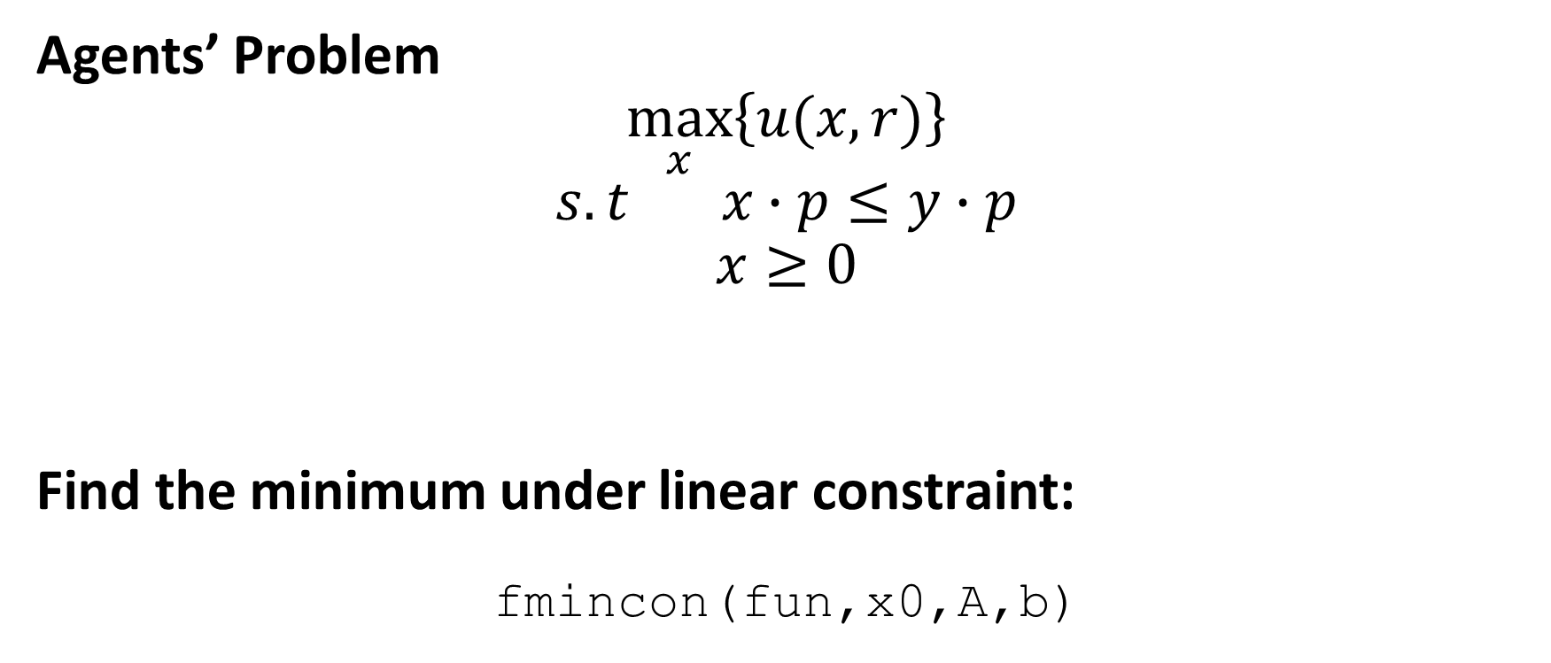
Step 3: Find Demand
Agents’ Problem
$$\max_{x}\left\{u(x,r)\right\}$$
$$s.t x∙p≤y∙p$$
$$x≥0$$
Find the minimum under linear constraint:
fmincon(fun,x0,A,b)

Slide 45

Setup Constrained Optimization
What is the objective?
$$fun=−u$$
What is A? What is b?
$$\left[\begin{matrix}p_{1} & p_{2} \\ −1 & 0 \\ 0 & −1\end{matrix}\right]∙x≤\left[\begin{matrix}p∙y \\ 0 \\ 0\end{matrix}\right]$$
What is a good guess?
$$x_{0}=y$$

Slide 46
demand.m
function [x, u] = demand(y, p, util)
f = @(z)(-util(z));
A = [p;-eye(2)];
b = [p*y';0 ;0];
[x, u] = fmincon(f,y,A,b);
u = -u;

Slide 47
Practice
Make a new box, with the endowment point, budget constraint, and two demand points (red for A, blue for B);
Add indifference curves at the individual demand points.

Slide 48
Step 4: Demand in Box
[x,u] = demand(y(1,:),p,utility);
scatter(x(1),x(2),50,'r','filled')
x_A1 = 0:0.01:u;
x_A2 = indiff(u,x_A1);
plot(x_A1,x_A2,'r','LineWidth',2)

Slide 49
Total Demand
function x = total_demand(y, p, utility)
x = [0 0];
for j = 1:size(y,1)
x_temp = demand(y(j,:),p,utility);
x = x + x_temp;
end

Slide 50
Practice
Draw the demand curve on the (P2,Q2) graph (Econ 101).
Add the supply curve using line/plot command.
P
S
D
q

Slide 51
Step 5: Supply and Demand
p2 = 0.1:0.01:1;
x2 = zeros(size(p2));
for j = 1:length(p2)
x_temp = total_demand(y,[1 p2(j)],utility);
x2(j) = x_temp(2);
end
figure; plot(x2,p2,'LineWidth',2);
line([totals(2) totals(2)], ...
[0 1],'LineWidth',2,'Color','k');

Slide 52
Step 6: Find Eq’m (Bisection)
d = 1; p_l = 0.1; p_h = 1;
while abs(d)> 0.01
p_star = (p_l+p_h)/2;
x = total_demand(y,[1,p_star],utility);
d = x(2)-totals(2);
if d>0
p_l = p_star;
else
p_h = p_star;
end
end

Slide 53
Practice
Draw equilibrium point and its indifference curve.
Run the code with r = 0.2 / r = 0.9.
What is the difference?

Slide 54
Problem Set 2
A few comments:
Make sure you understand the timing of the problem
When is recursion appropriate?
Speed: Vectorization > Loops > Recursion
Readability: Vectorization < Loops < Recursion
- Question 3

